Slide 1
Web-Enabled Search Tool for Identifying Personally Identifiable Information
By
Adarsh Gautam
Bhanu Prakash B
Syed Thowfeeq Ahmed

Slide 2

Abstract
Safeguarding personally identifiable information (PII) is crucial because such information is increasingly used to engineer privacy attacks, identity thefts and security breaches. But is it likely that individuals may choose to just share this information with strangers? We find that individuals not only reciprocate and share PII when the disclosure of such information is private and directed towards them by a stranger, but also when the stranger shares this information through a public channel that is not directed towards anyone in particular. The project focus to Identify personally identifiable information on such public or open web sites and notifying user about the availability .

Slide 3
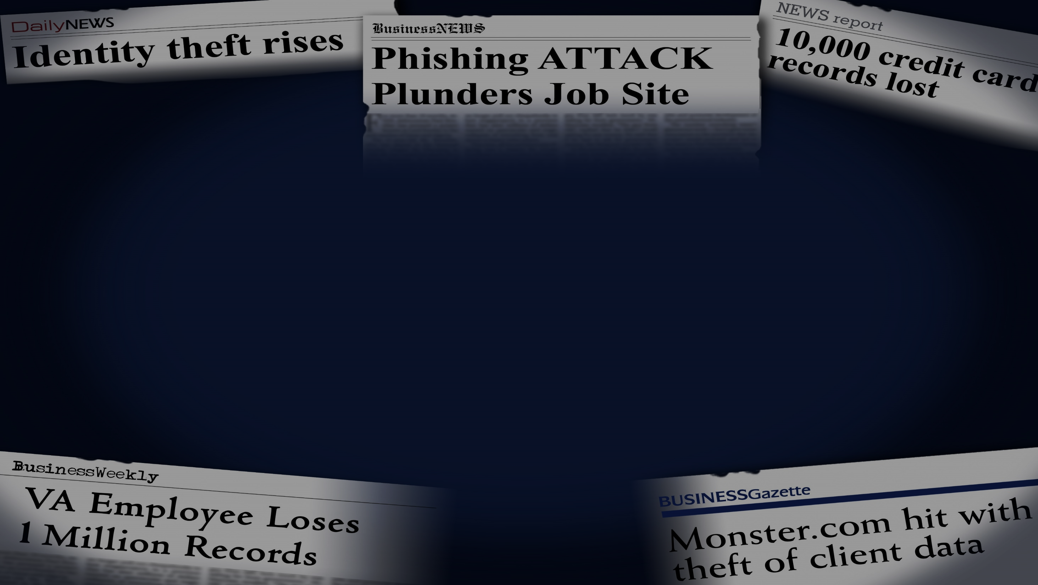
Personally Identifiable Information (PII):
Information about an individual including but not limited to, Education, Employment, Financial Transactions, Medical History, and Criminal Background information which can be used to distinguish or trace and individual’s identity, such as their name, social security number, date and place of birth, mother’s maiden name, biometric records etc. , including any other personal information that can be linked to an individual.
Don’t become a headline!

Slide 4
MOTIVATION

Slide 5
Data Protection Laws in India
Information Technology Act, 2000
Under section 43A of the (Indian) Information Technology Act, 2000, a body corporate who is possessing, dealing or handling any sensitive personal data or information, and is negligent in implementing and maintaining reasonable security practices resulting in wrongful loss or wrongful gain to any person, then such body corporate may be held liable to pay damages to the person so affected

Slide 6
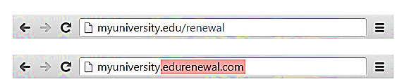
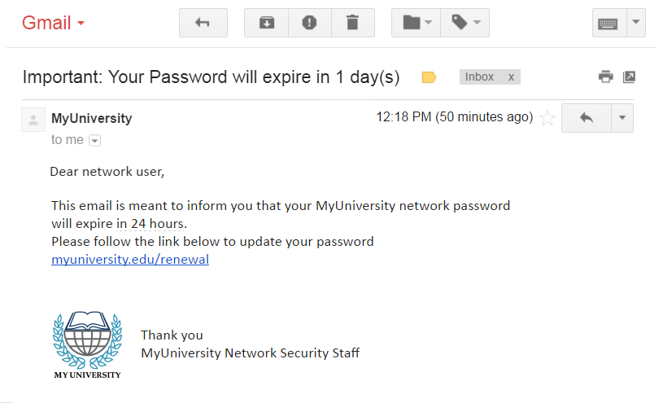
PHISHING ATTACKS

Slide 7
PHISHING PROTECTION
Simple steps to be taken to Avoid Phishing Attack
For users, vigilance is key.
A spoofed message often contains subtle mistakes that expose its true identity. These can include spelling mistakes or changes to domain names, as seen in the earlier URL example
Users should also stop and think about why they’re even receiving such an email.

Slide 8





Identity Theft is Everyone’s Problem
Identity theft is the fastest growing crime.
Someone’s identity is stolen every 2-3 seconds.
The average loss per identity theft incident is $4,930.
On average it takes 600 hours to recover from identity theft.
Source: Trans Union Website, January 14, 2015
Source: https://identity.utexas. edu/id-perspectives/top-10-myths-about-identity-theft
Source: U.S. Department of Justice, Javelin Strategy & Research
Source: The Identity Theft Resource Center website, April 28, 2015
Notes:
Before we dive into our training today, I want to paint a picture of the threats we and our clients face.
Unfortunately, fraud and identity theft are a growth industry. The number of incidents, the cost of mitigation, and the sophistication of cybercriminals are all on the rise. Just look at these statistics.

Slide 9
Identity Theft is Everyone’s Problem
13.1 million
people experienced identity theft in 2015.
63% of confirmed data breaches involved weak, default, or stolen passwords.
Over 95% of all security incidents investigated recognized ‘human error’ as a contributing factor.
Source: Javelin 2016 Identity Fraud Study
Source: Verizon 2016 Data Breach Investigations Report
Source: IBM Security Services 2014 Cyber Security Intelligence Index
Notes:
As you can see from this slide, cyber crimes are on the rise. The number of cyber incidents, the cost of mitigation, and the sophistication of cyber criminals are all steadily increasing. One of the top risk factors is human error – so strengthening our awareness, becoming aware of suspicious activity, asking questions and being diligent in our day-to-day processes and client interactions is critical to helping prevent fraud and cyber breaches.
My intention isn’t to frighten you, but the reality is that for many people and companies, it’s not a matter of if but when they’ll become victims of cyber crime. It is critically important that we work together to protect our client and firm information and assets.
So, while our firm and our custodian, Charles Schwab and Co., Inc., takes protective measures and constantly adjusts our cybersecurity programs to keep up with emerging cyber trends, the very best way to enhance these efforts is for each of us, along with our clients to work together to ensure these criminals can’t access our data or accounts.

Slide 10
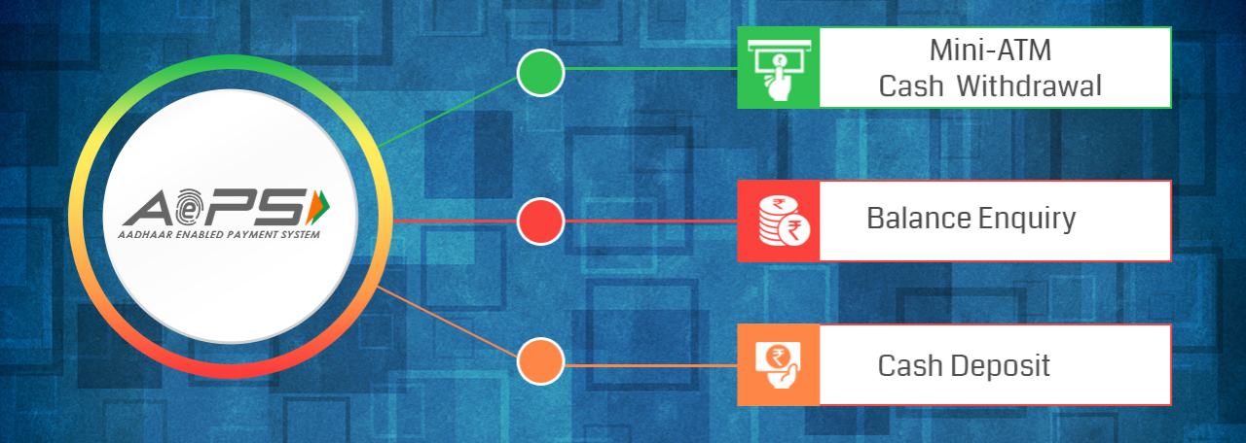
Aadhaar enabled payment system!!
Aadhaar number, bank name and thumb/finger impression.

Slide 11
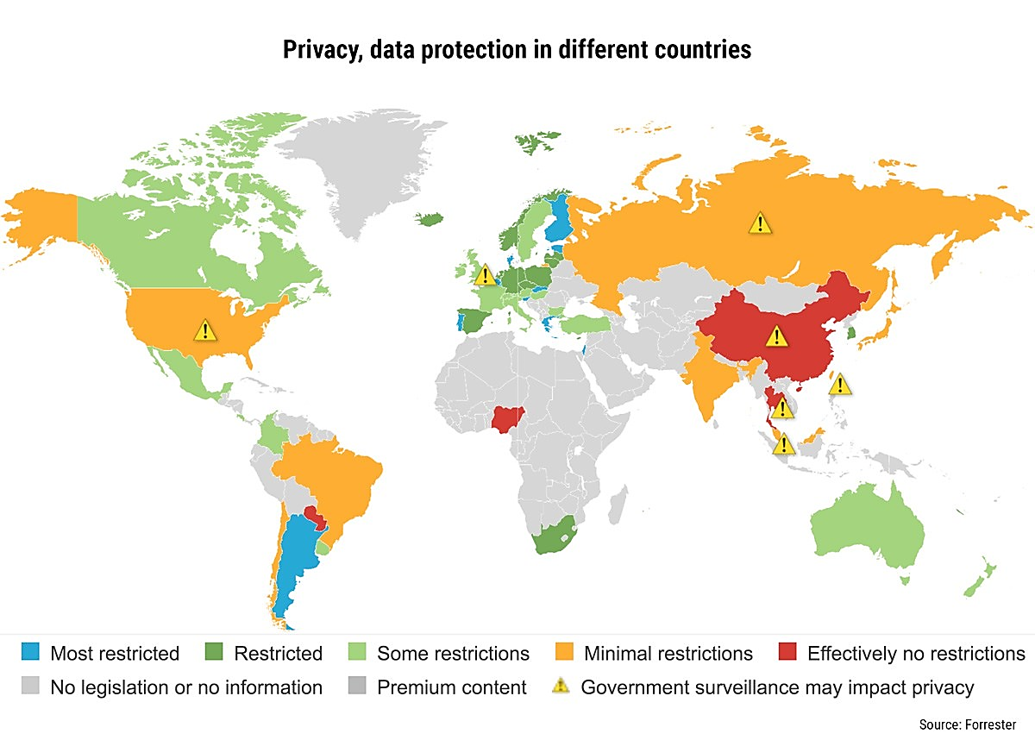

Slide 12
Comparing Existing with Proposed Solution

Slide 13



Existing Solution
Web Interface tool where user’s sensitive information should be uploaded
mostly Entrepreneurship purpose
much cost
vulnerable to hackers.

Slide 14
Proposed Solution
Web Enabled tool
Cost Free
Available to anyone
Notify the user
Robust
Not Vulnerable to hackers
This tool is developed using Python and MongoDB which makes it robust and doesn’t hold any sensitive information and therefore it is not vulnerable to hackers.

Slide 15


Why?
It has a comprehensive and large standard library that has automatic memory management and dynamic features. Python has top the charts in the recent years over other programming languages like C, C++ and Java and is widely used by the programmers
Schema less − MongoDB is a document database in which one collection holds different documents. Number of fields, content and size of the document can differ from one document to another. ...

Slide 16
How Cybercriminals use Stolen Data ?
Cybercriminals are constantly trying to steal data and identities:
Personal Data Stolen
Social Security numbers
Usernames
Date of birth
Passwords
Credit card numbers
Account numbers
Employment information
Checks
Resulting Crimes
Fraudulent Transactions
– account opening
--deduct money from bank
Identity Theft
– using stolen Social Security numbers for employment or other gain
– filing a false tax return
– impersonating another person
-- blackmail
--creating acc. on your name
Notes:
In addition to the examples we’ve already discussed, I should point out that cybercriminals also access confidential data when stealing devices like cell phones, tablets, and laptops. And, on the right you can see more examples of crimes resulting from the theft of personal information.
Fraudulent transactions include trading, electronic funds transfer, wire transfers, opening unauthorized accounts, and more. And, identity theft can result in these and other crimes.

Slide 17
Working Description
USER INTERFACE OPENS TO TAKE IN KEYWORD
GIVEN KEYWORD IS SEARCHED IN GOOGLE AND SEARCH RESULTS ARE RETRIEVED AND STORED IN MONGODB
RETRIEVED URLS ARE USED TO GET THE CONTENTS FROM THE SITES
THE CONTENTS FROM URLS ARE USED TO CATEGORIZE URLS
FINALLY SITES SHOWING COMPLETE INFORMATION ARE DISPLAYED IN USER INTERFACE

Slide 18
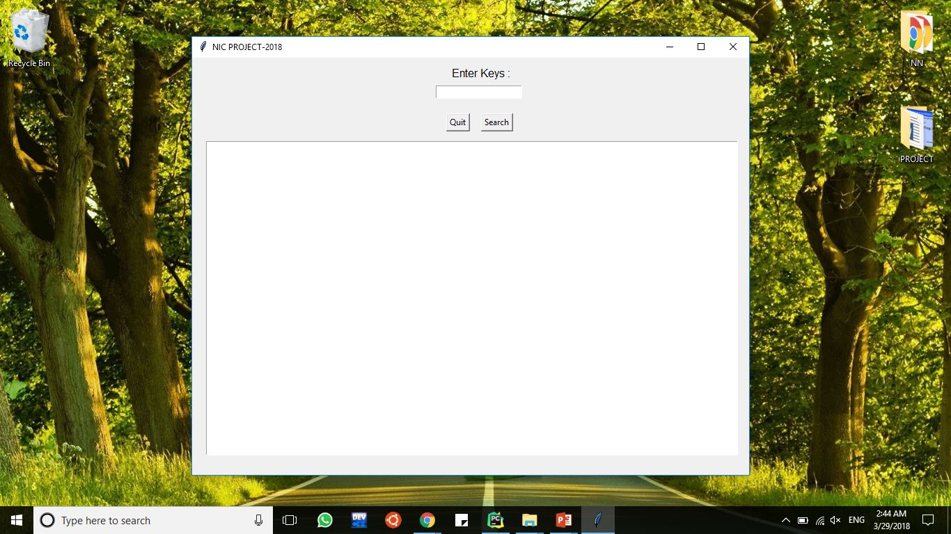
SCREEN SHOTS : USER INTERFACE

Slide 19
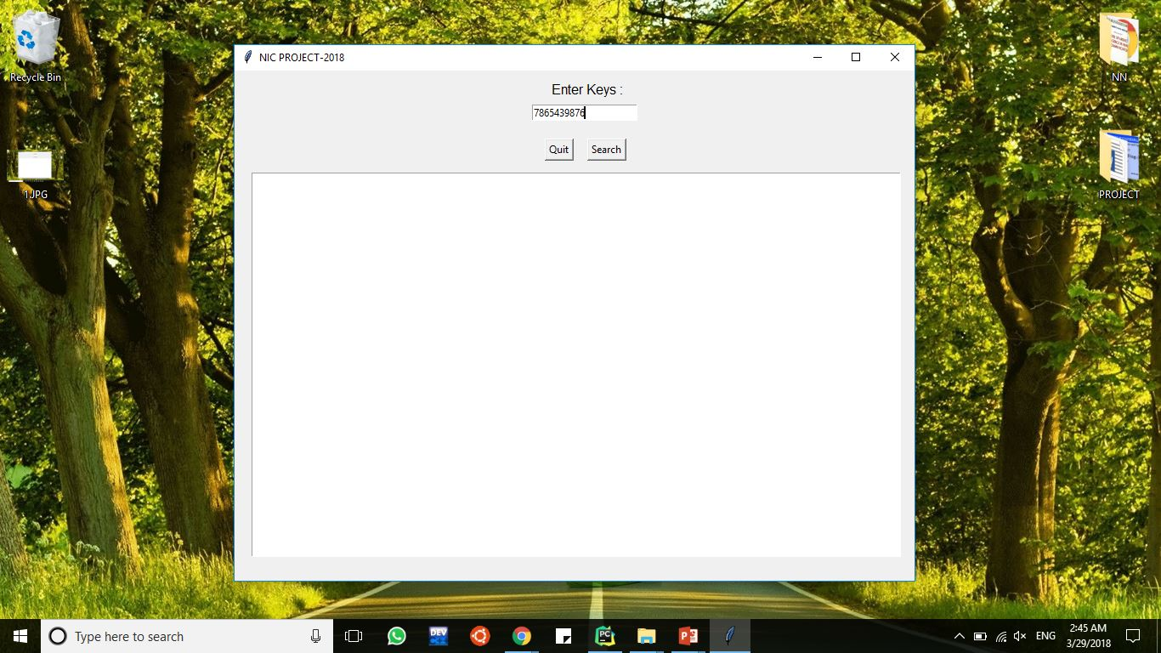
SCREEN SHOTS : TAKING INPUT

Slide 20
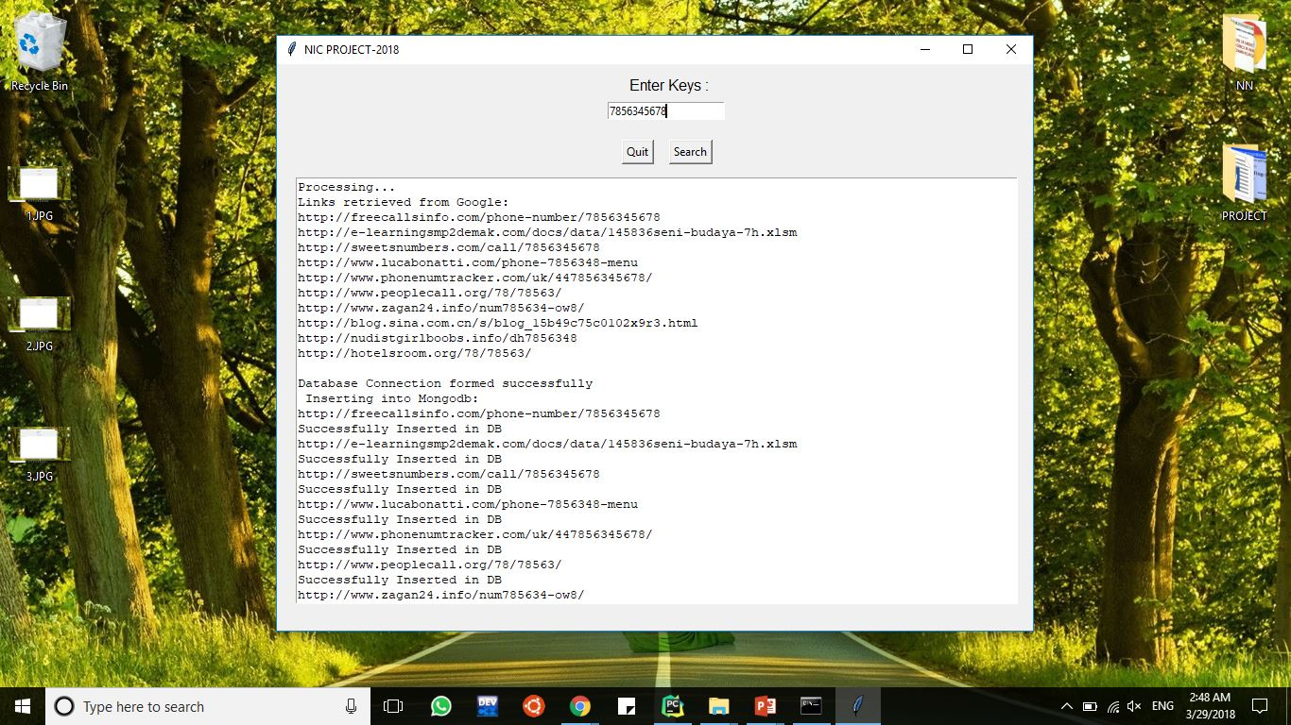
SCREEN SHOTS : GIVING OUTPUT

Slide 21
Uber
Uber concealed a hack that affected 57 million customers and drivers worldwide and 2.7 million users in the UK, the company has confirmed.
The breach - which took place in 2016 - was kept under wraps by the taxi-hailing firm, which paid hackers $100,000 (£75,000) to delete the data.
"None of this should have happened, and I will not make excuses for it.“
Pizza Hut
Pizza Hut has revealed that its website and app were hacked on 1 October, with personal information for an undisclosed amount of customers being jeopardised.
The hack is thought to have compromised billing information including delivery addresses, email addresses and payment card information containing account numbers, expiration dates and CVV numbers.

Slide 22
REFERENCES
Johnson III, C. Safeguarding Against and Responding to the Breach of Personally Identifiable Information, May 22 2007. Office of Management and Budget Memorandum
Stutzman, F. and Kramer-Duffield, J. (2010) Friends Only: Examining a Privacy-Enhancing Behavior in Facebook. Proc. Conf. Human Factors and Computing Systems: CHI 2010, pp. 1553–1562. ACM Press.
http://www.spicedigital.in/aadhaar-enabled-payment-system/
“A Chronology of Data Breaches,” Privacy Rights ClearingHouse, April 20, 2005. [Online] Available: http://www.privacyrights.org/ar/ChronDataBreaches.htm. [Accessed: Sept. 29, 2009

Slide 23
Thank you
Open to Questions

